Slide 1
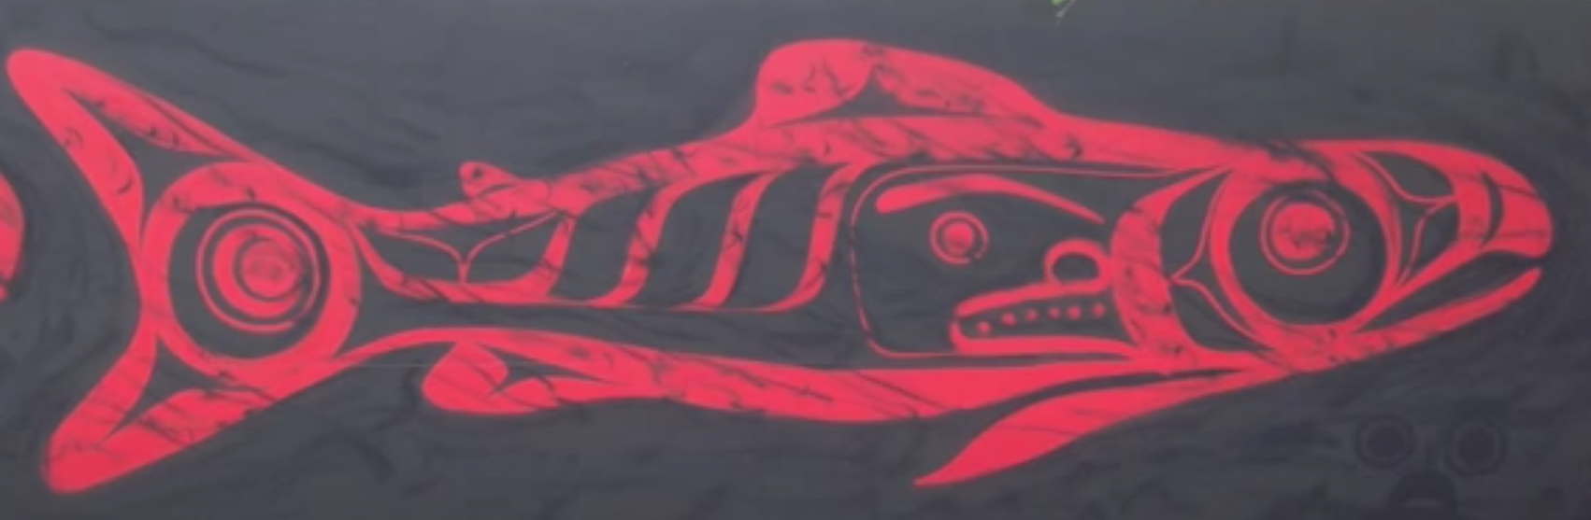
Juvenile Pink and Chum Salmon Trophic Interactions
Vanessa Fladmark / Vanessa Zahner
MSc Committee Meeting # 4
July 14th, 2020

Slide 2
Outline
Introduction
Spatial Chapter – recap
Temporal Chapter – ideas
Conclusion
Timeline

Slide 3
Introduction: Coexistence or Competition?
Historical salmon coexistence
Different life cycles and life history
Current salmon stocks declining
Need to understand complexity
Juvenile is an important life phase
Pink and chum salmon diets understudied
Competition between adult salmon
This study – juvenile pink-chum salmon feeding interactions

Slide 4
Spatial Data: Pink – Chum Prey Partitioning
Pink and chum salmon emerge from freshwater early in life cycle
Pink and chum salmon are planktivorous in the early marine phase
Adult pink salmon outcompete other species for higher quality prey
Adult chum salmon shift diets to gelatinous in response to low food
Foraging and competition of juvenile pink and chum are understudied
In southern B.C. “Trophic Gauntlet” for planktivorous juvenile sockeye
Trophic gauntlet likely also exists for juvenile pink and chum salmon
In low foraging, pink and chum will either compete or shift their diets

Slide 5
Spatial Data: Research Questions and Aims
Does the “trophic gauntlet” exist for juvenile pink and chum salmon? Under low foraging will they compete or separate by niche to coexist?
1) Quantify juvenile pink and chum salmon diets in contrasting foraging conditions in southern coastal B.C.
2) Describe the trophic niches pink and chum salmon occupy
3) Assess the potential competition in contrasting foraging conditions

Slide 6
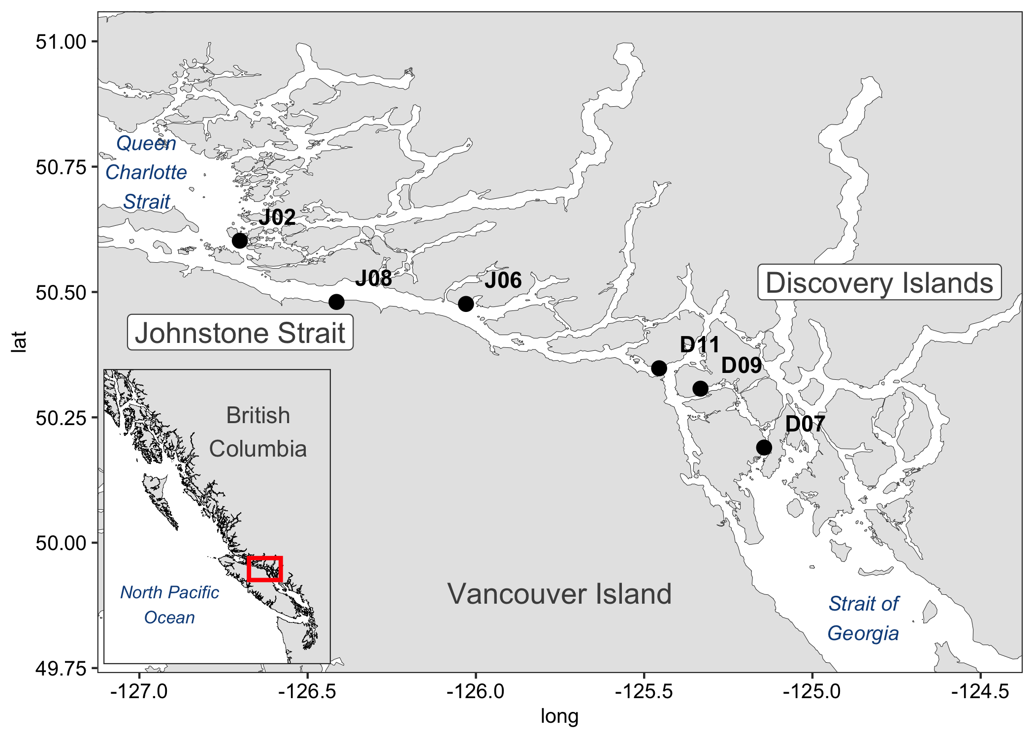
Spatial Data: Migration Route – June 2016

Slide 7
Spatial Data: Sampling Table

Slide 8
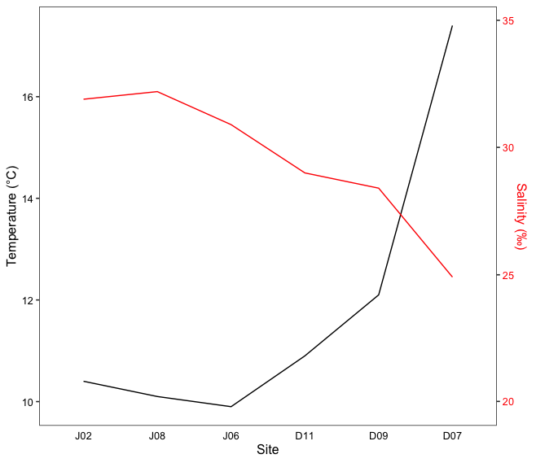
Spatial Data: Environmental Conditions

Slide 9
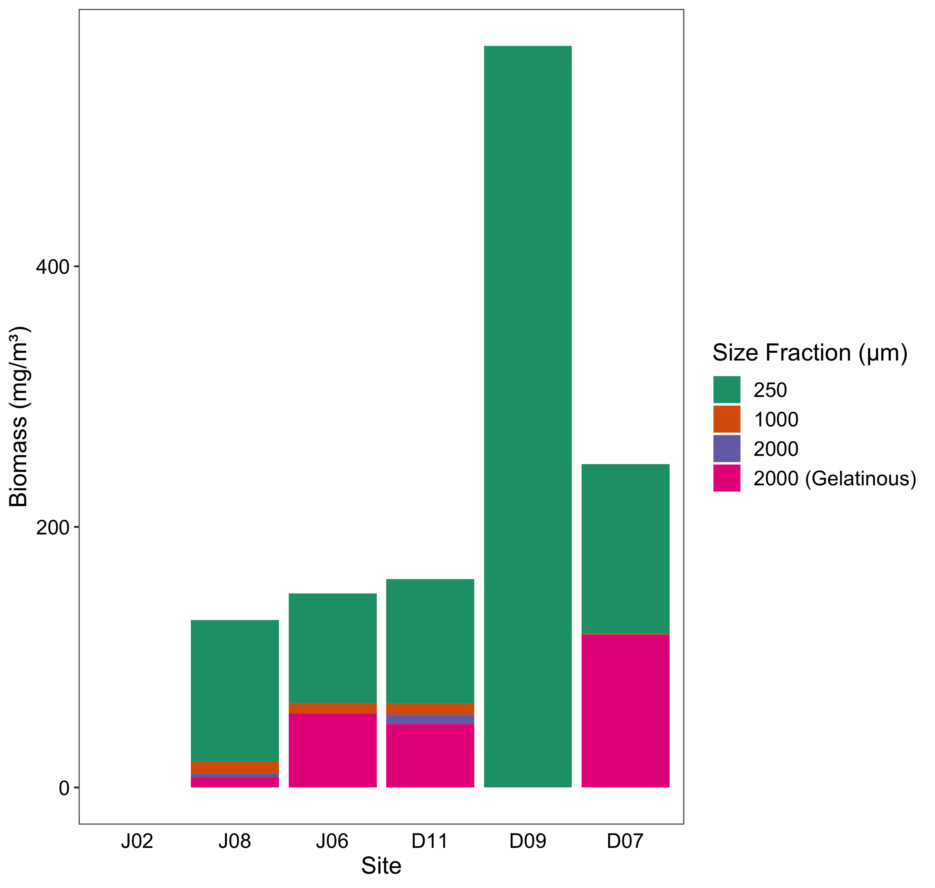
Spatial Data: Zooplankton Biomass

Slide 10
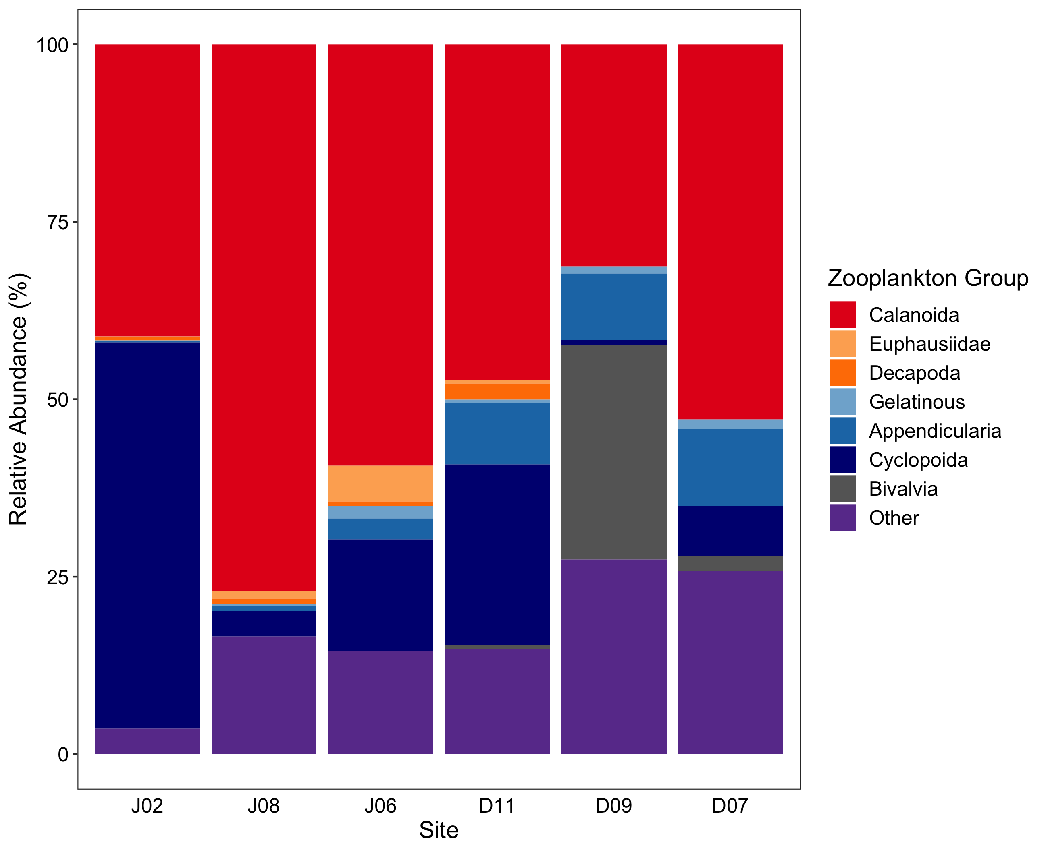
Spatial Data: Zooplankton Relative Abundance

Slide 11
Spatial Data: Zooplankton Relative Abundance

Slide 12
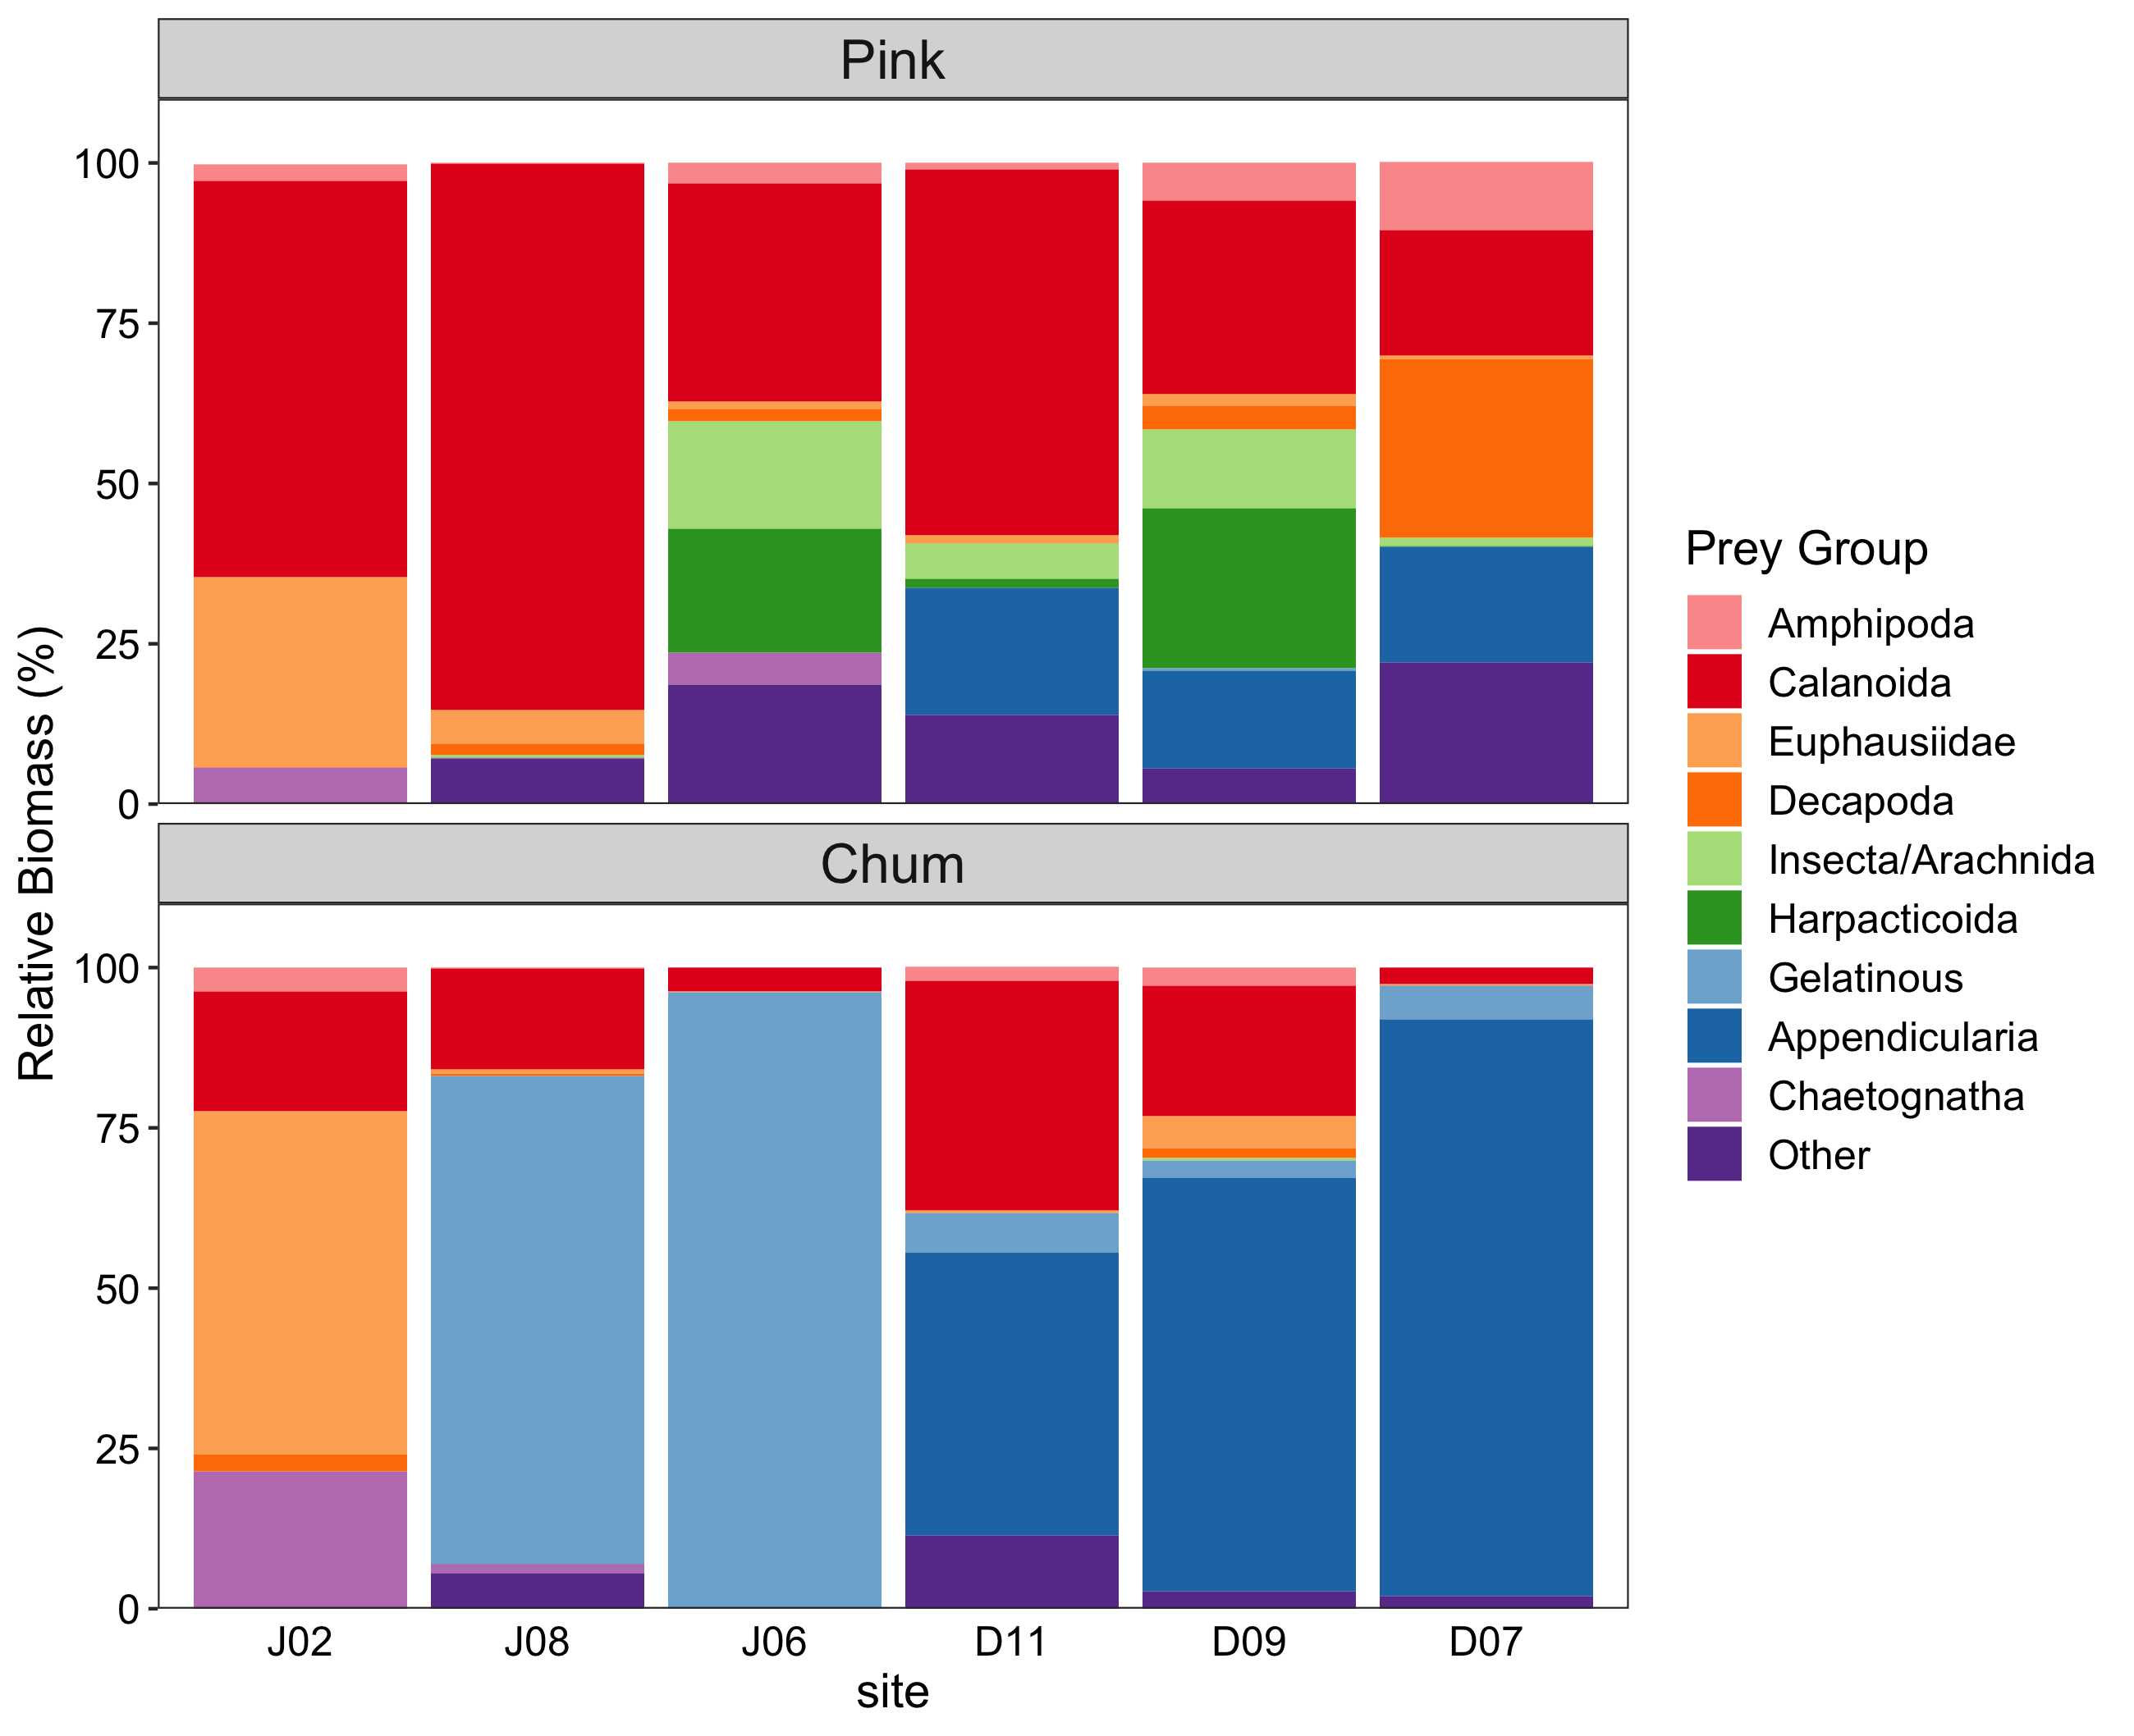
Spatial Data: Pink – Chum Diet Composition

Slide 13
Spatial Data: Pink – Chum Diet (%WW) Table

Slide 14
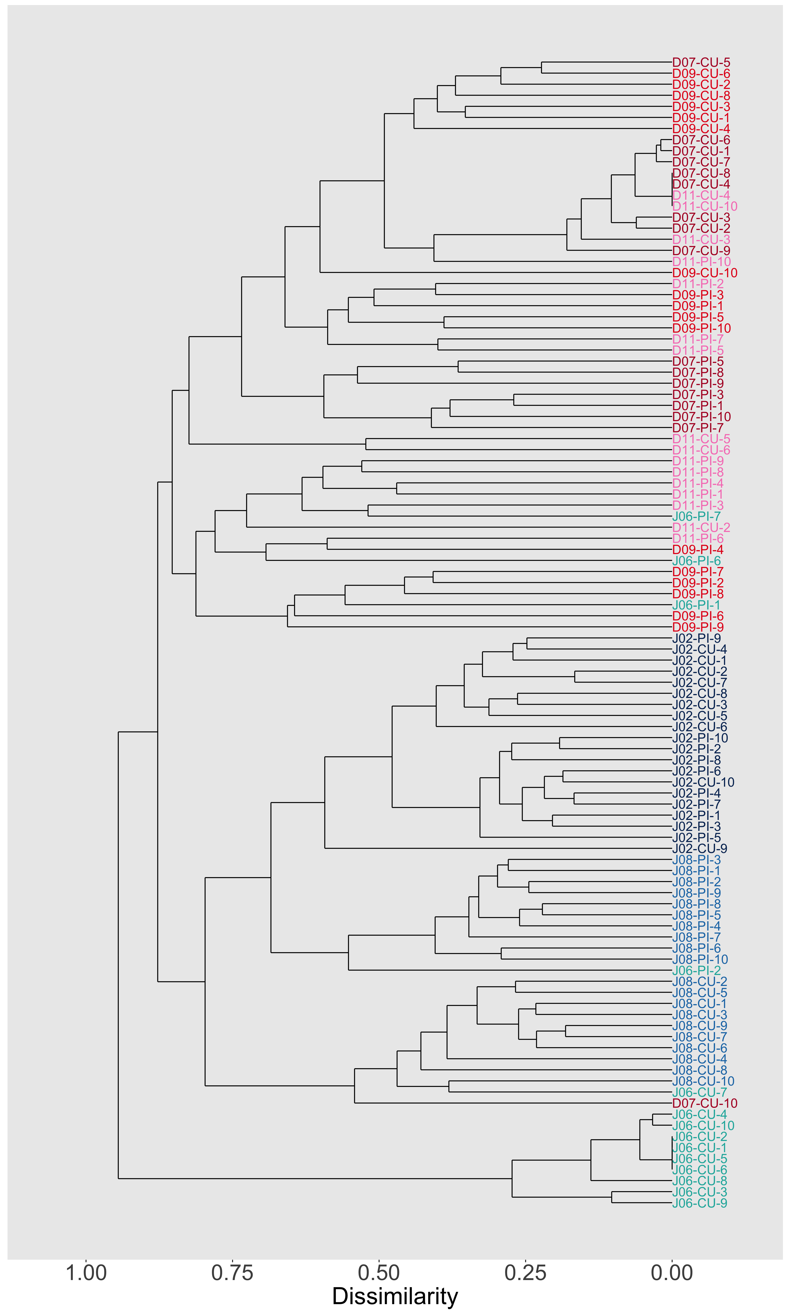
Spatial Data: DI – JS Difference Diet Cluster
Discovery Islands
Queen Charlotte Strait
Johnstone Strait (West)
Johnstone Strait (East)

Slide 15
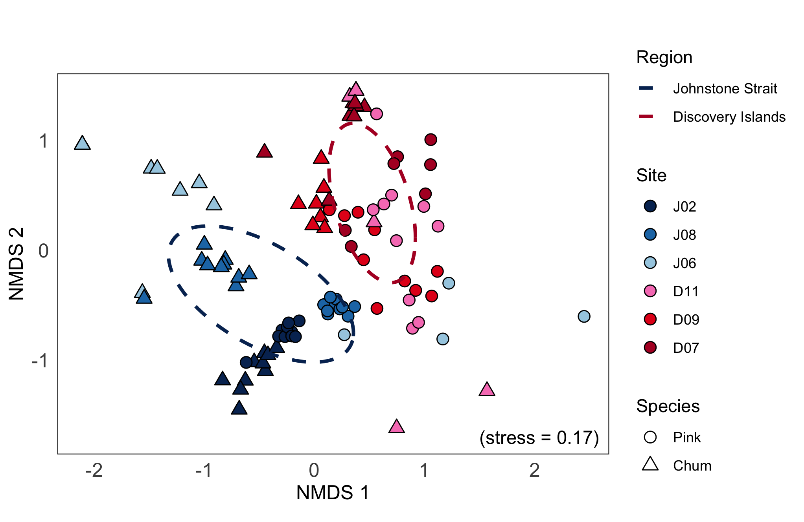
Spatial Data: Salmon Diet Differences – NMDS

Slide 16
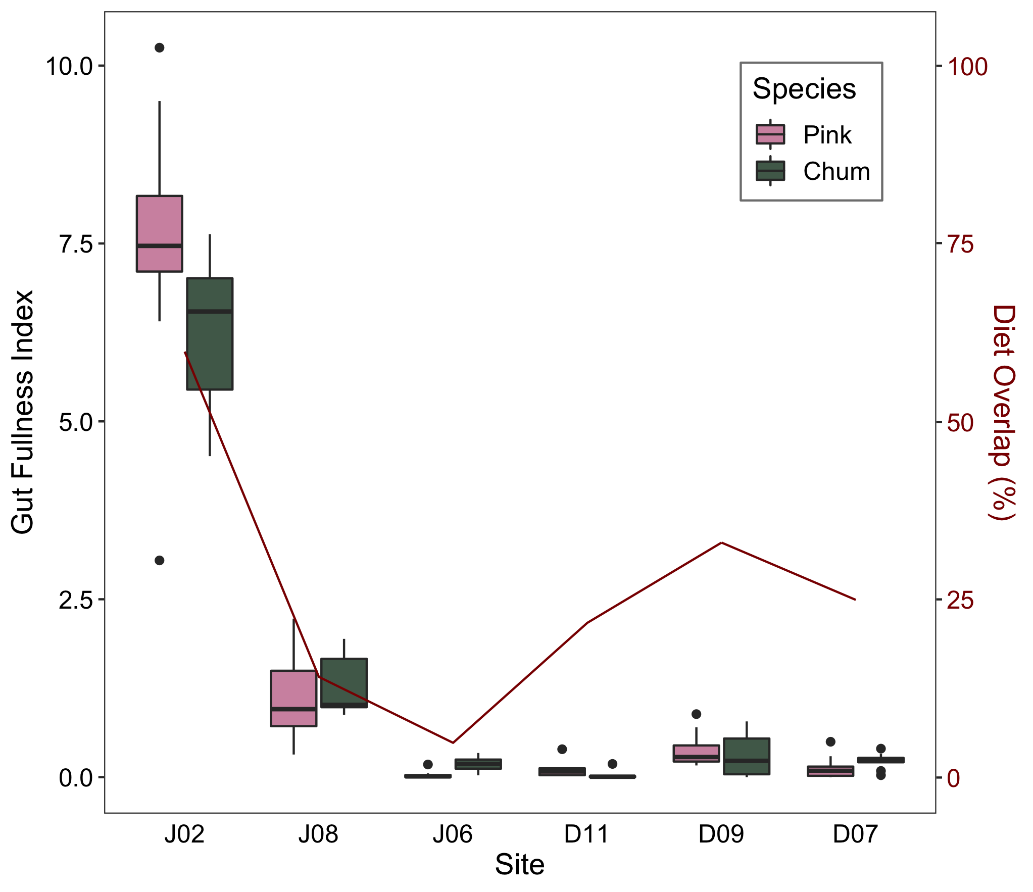
Spatial Data: Pink – Chum Fullness + Overlap

Slide 17
Spatial Data: Salmon Biology/Indices Table

Slide 18
Spatial Data: Trophic Gauntlet Discussion
1) Quantifying diets in contrasting foraging conditions:
Pink: calanoid, decapod, harpacticoid (low) → calanoid, euphausiid (high)
Chum: Oikopleura/Cnidaria (low) → euphausiid, calanoid, chaetognath (high)
2) Describe the trophic niches pink and chum salmon occupy
Pink = littoral (harpacticoid, insect); chum = gelatinous (Cnidaria, Oikopleura)
3) Assess potential competition in contrasting foraging conditions
Low diet overlap <35% between pink and chum salmon when GFI <1.5% BW
High diet overlap 60% of crustacean prey in pink and chum when GFI <5% BW
Prey partitioning between species reduces competition in the trophic gauntlet

Slide 19
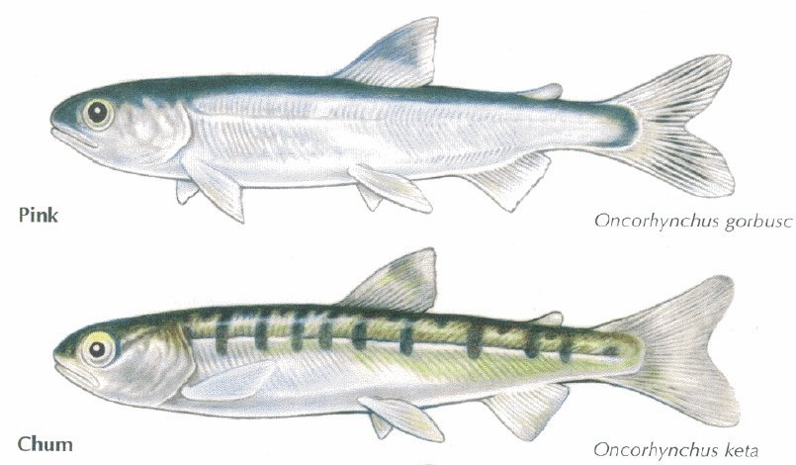
Spatial Data: Summary/Conclusion
High foraging: similar diets Low foraging: different niches
Trends hold even in these two regions of high diet dissimilarity: DI & JS

Slide 20
Temporal Data: Migration and prey phenology
TBD

Slide 21
Temporal Data: Research Questions and Aims
TBD …

Slide 22
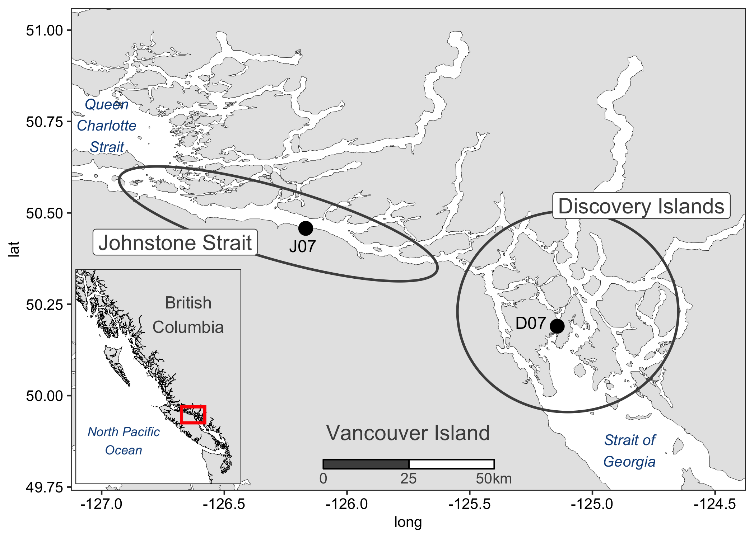
Temporal Data: Sampling Season 2015 – 2016

Slide 23
Temporal Data: Sampling Season 2015 – 2016

Slide 24
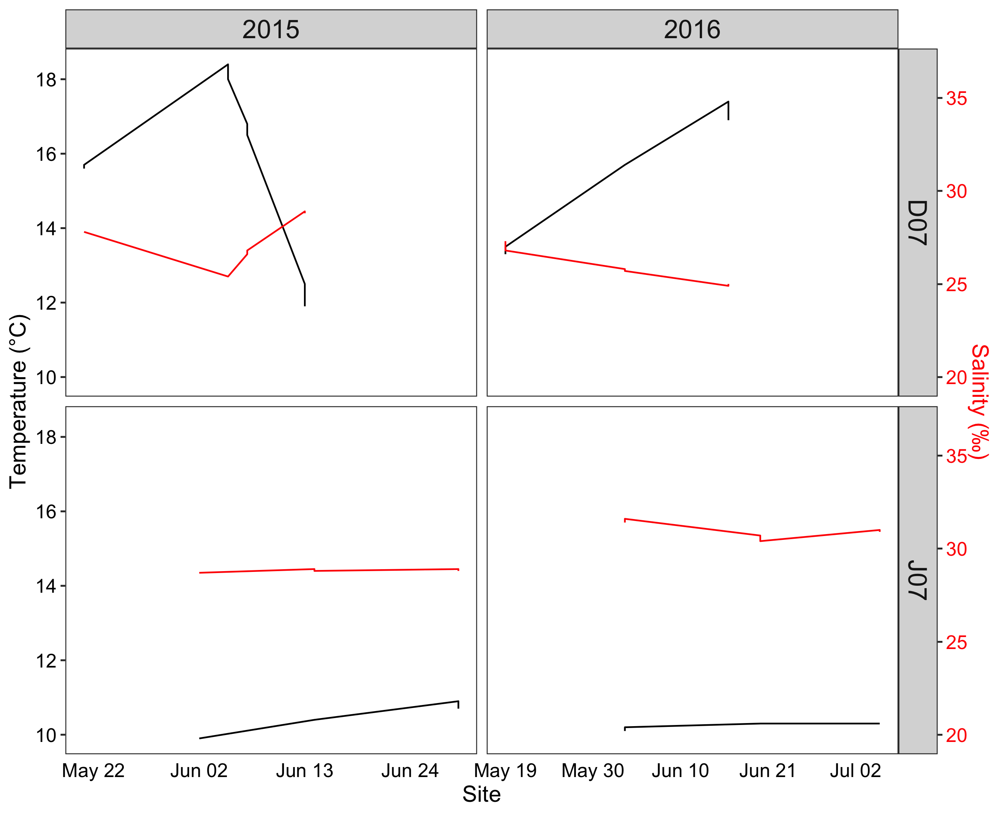
Temporal Data: Environmental Conditions

Slide 25
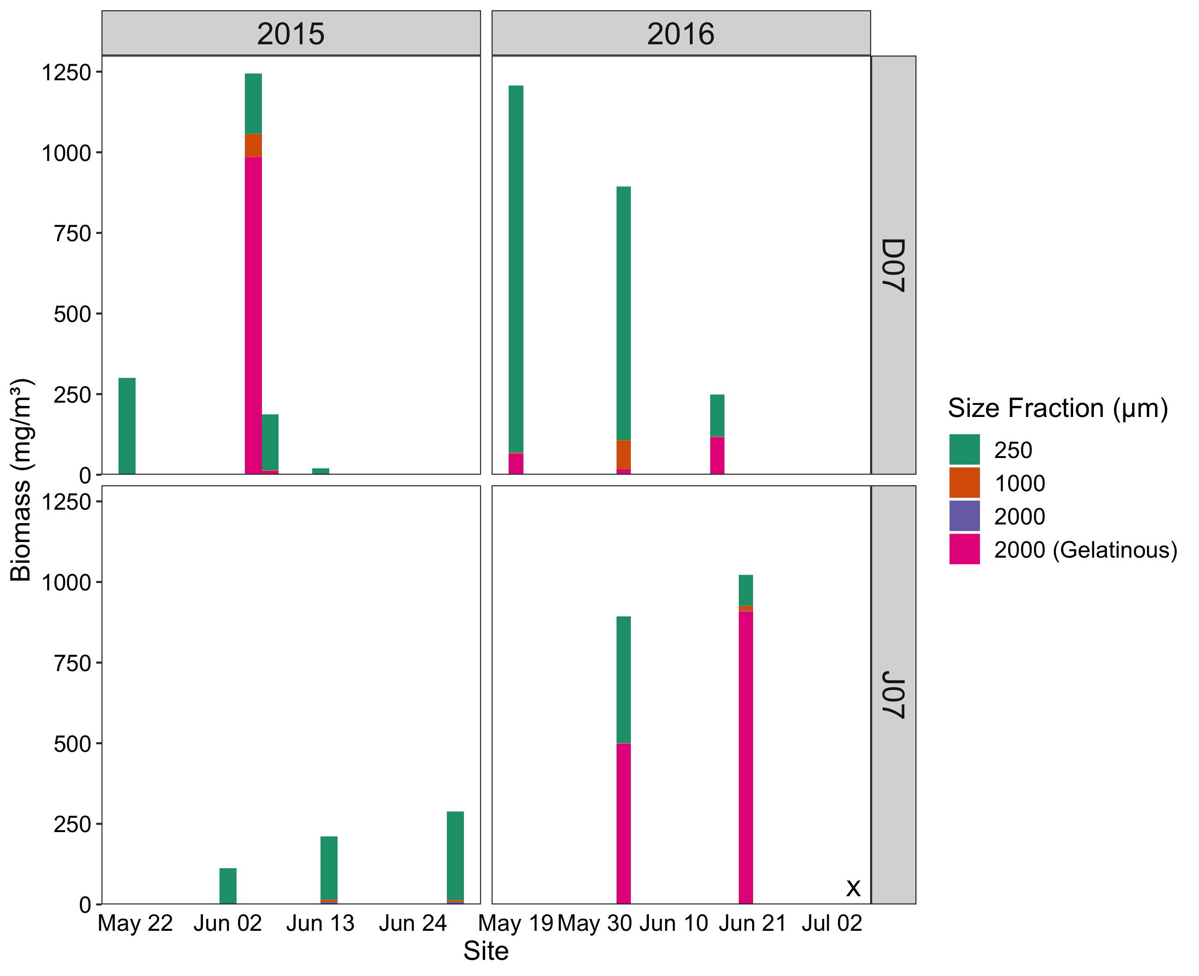
Temporal Data: Zooplankton Biomass

Slide 26
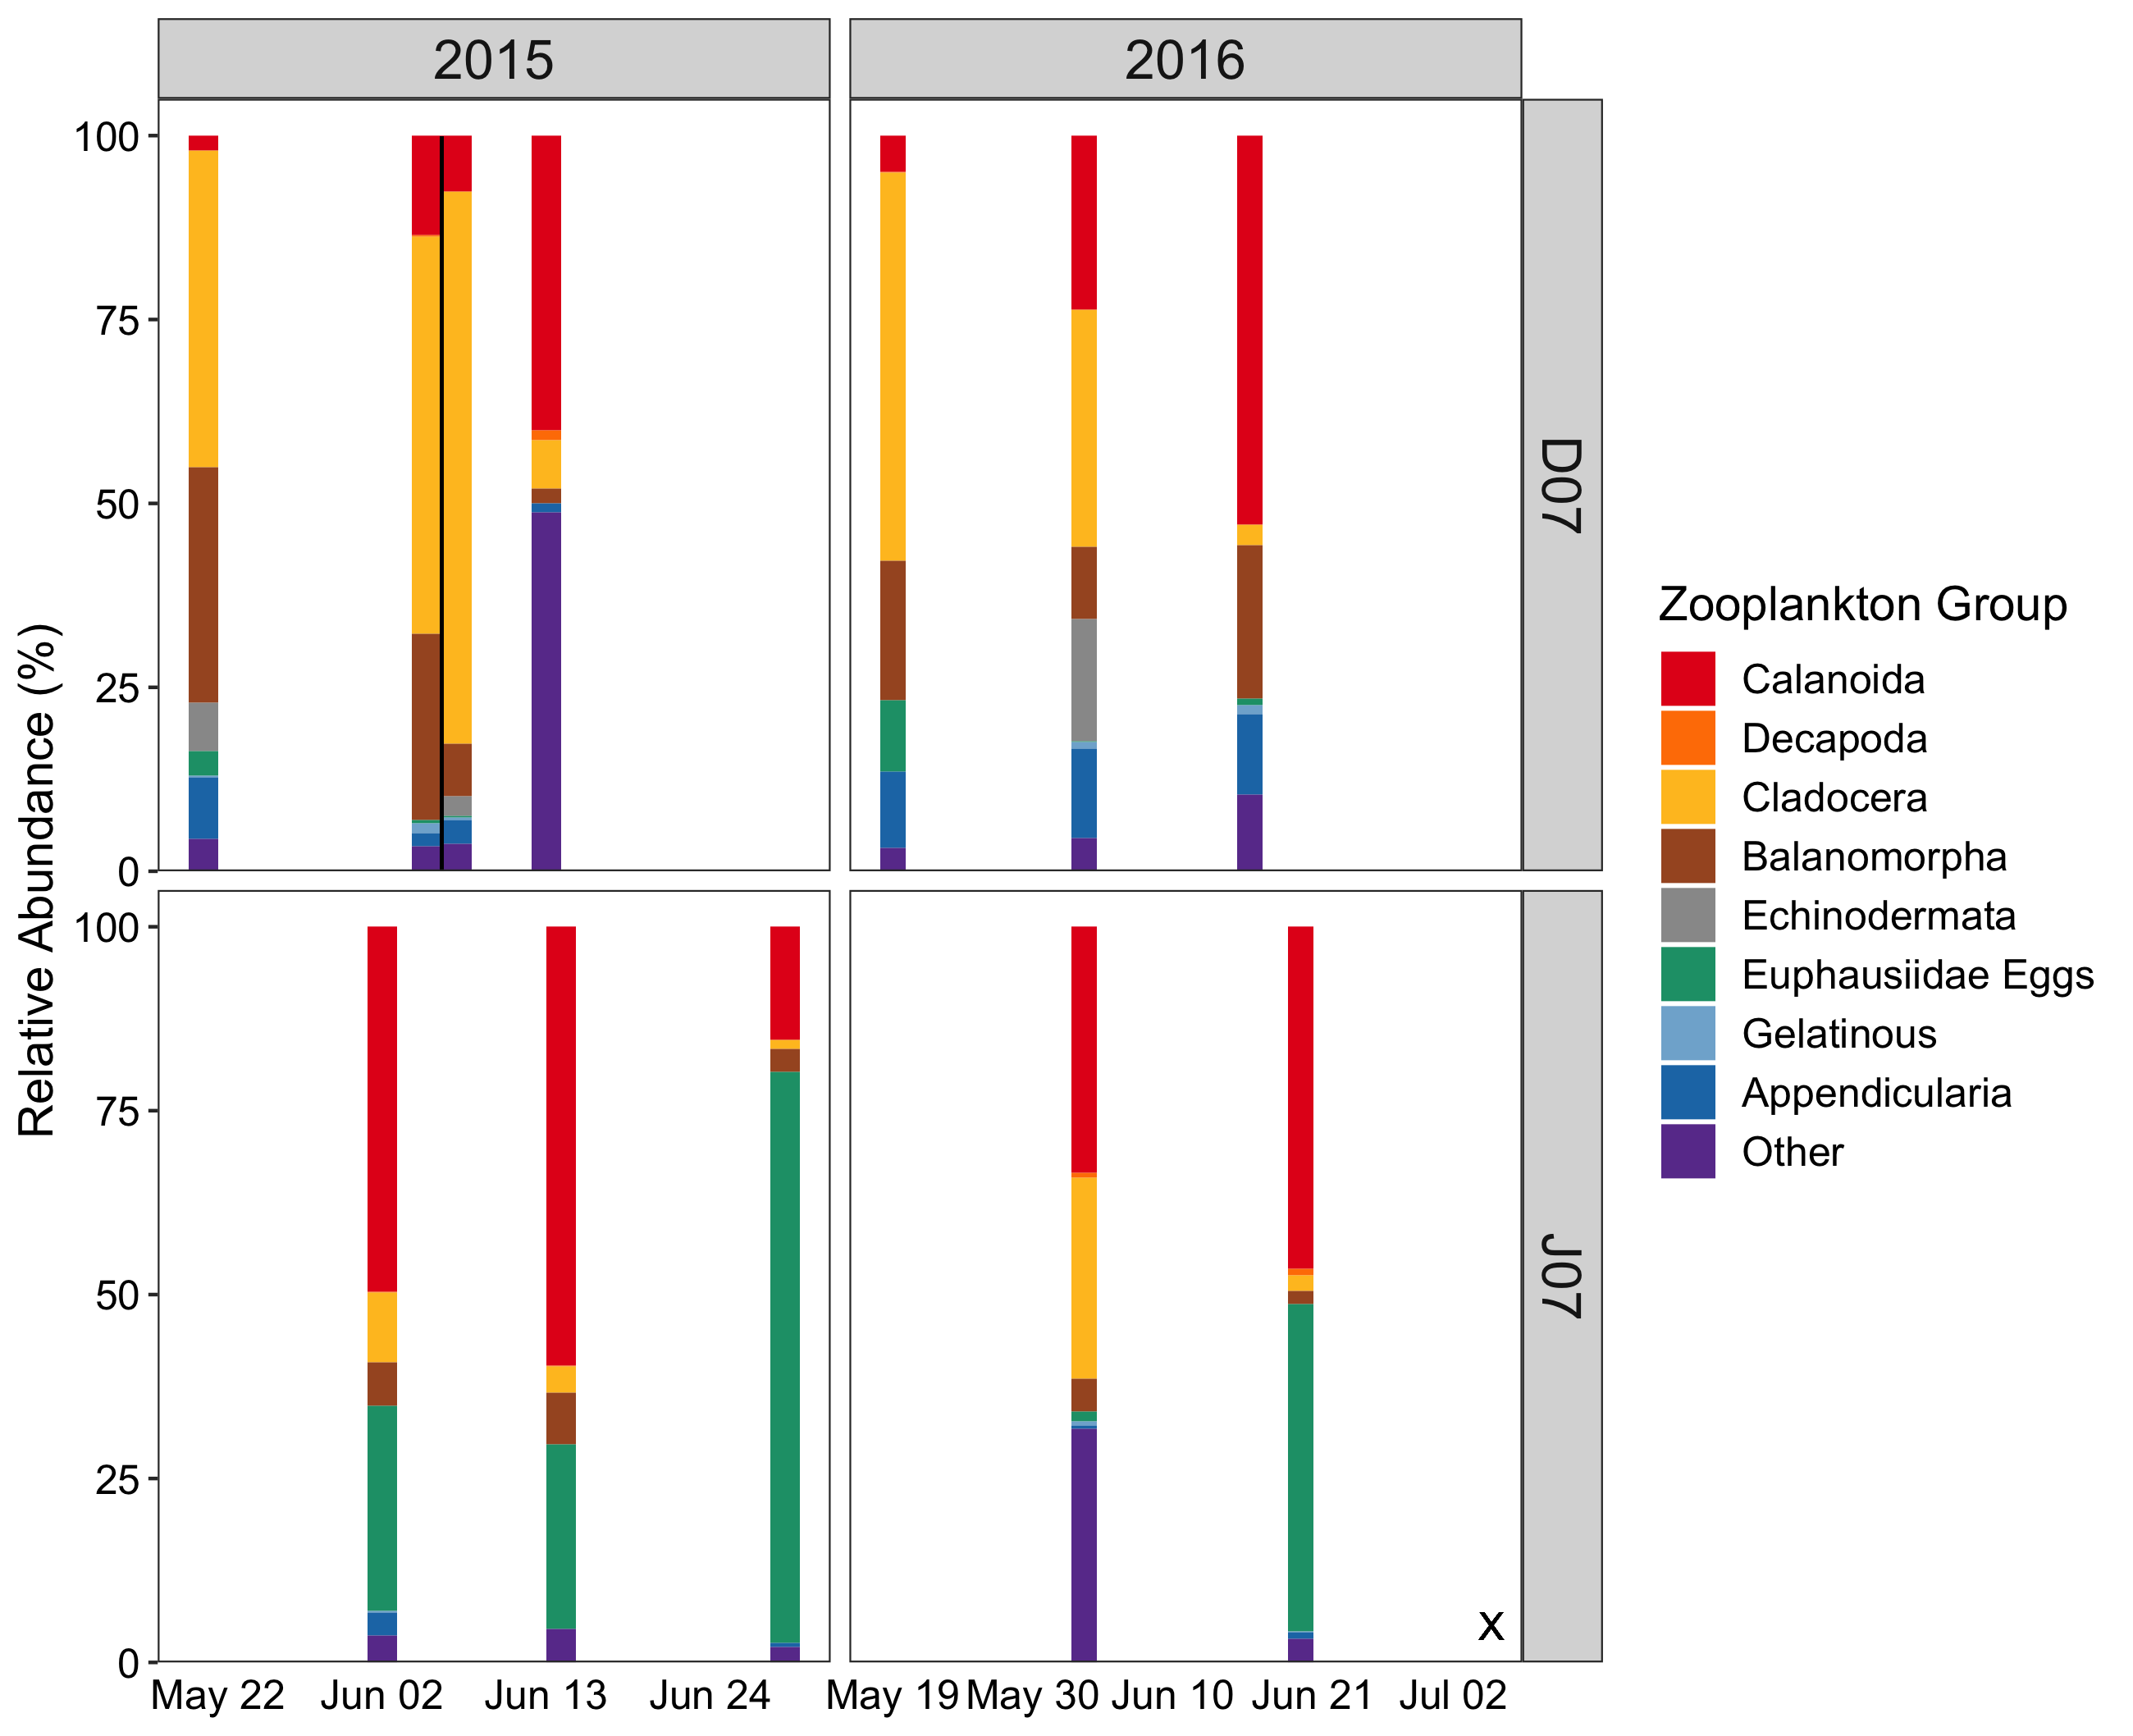
Temporal Data: Zooplankton Rel. Abundance

Slide 27
Temporal Data: Zooplankton Rel. Abundance

Slide 28
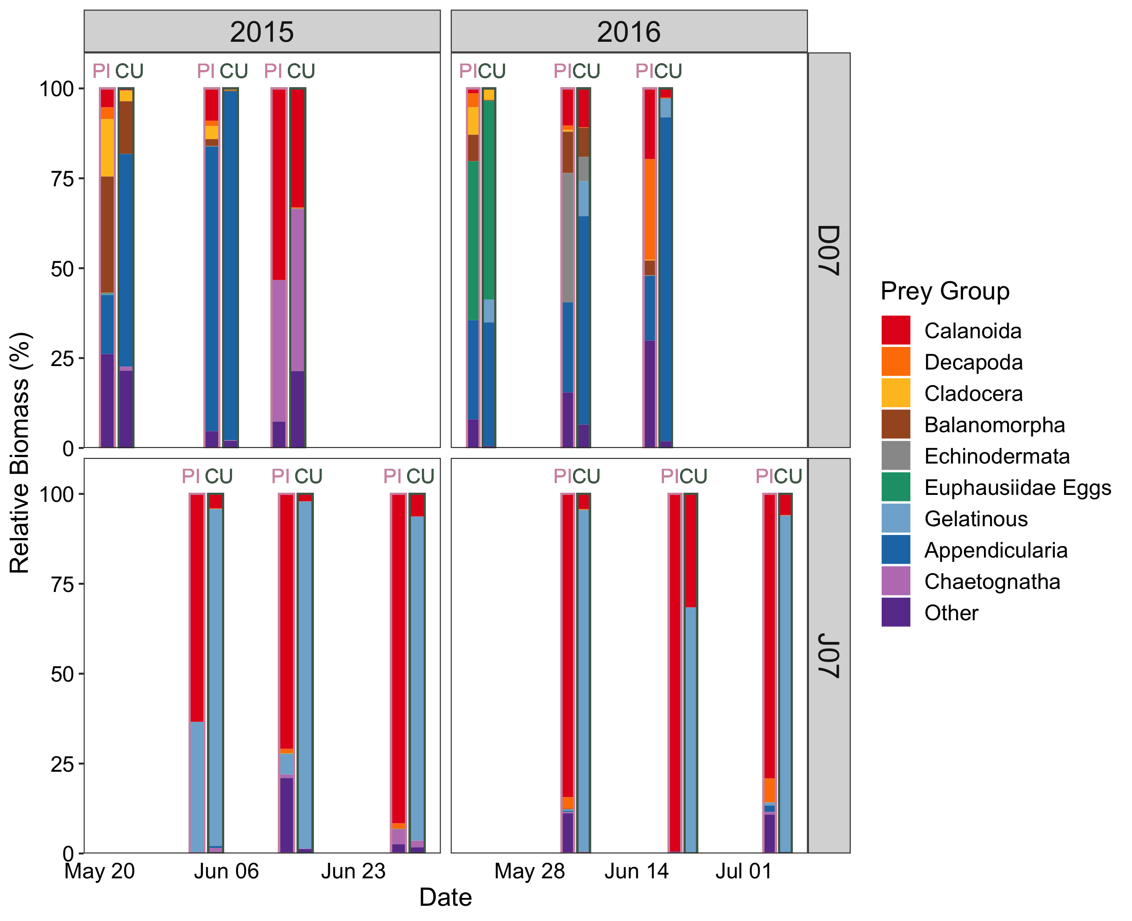
Temporal Data: Pink – Chum Diet Composition

Slide 29
Temporal Data: Pink – Chum Diet Composition

Slide 30
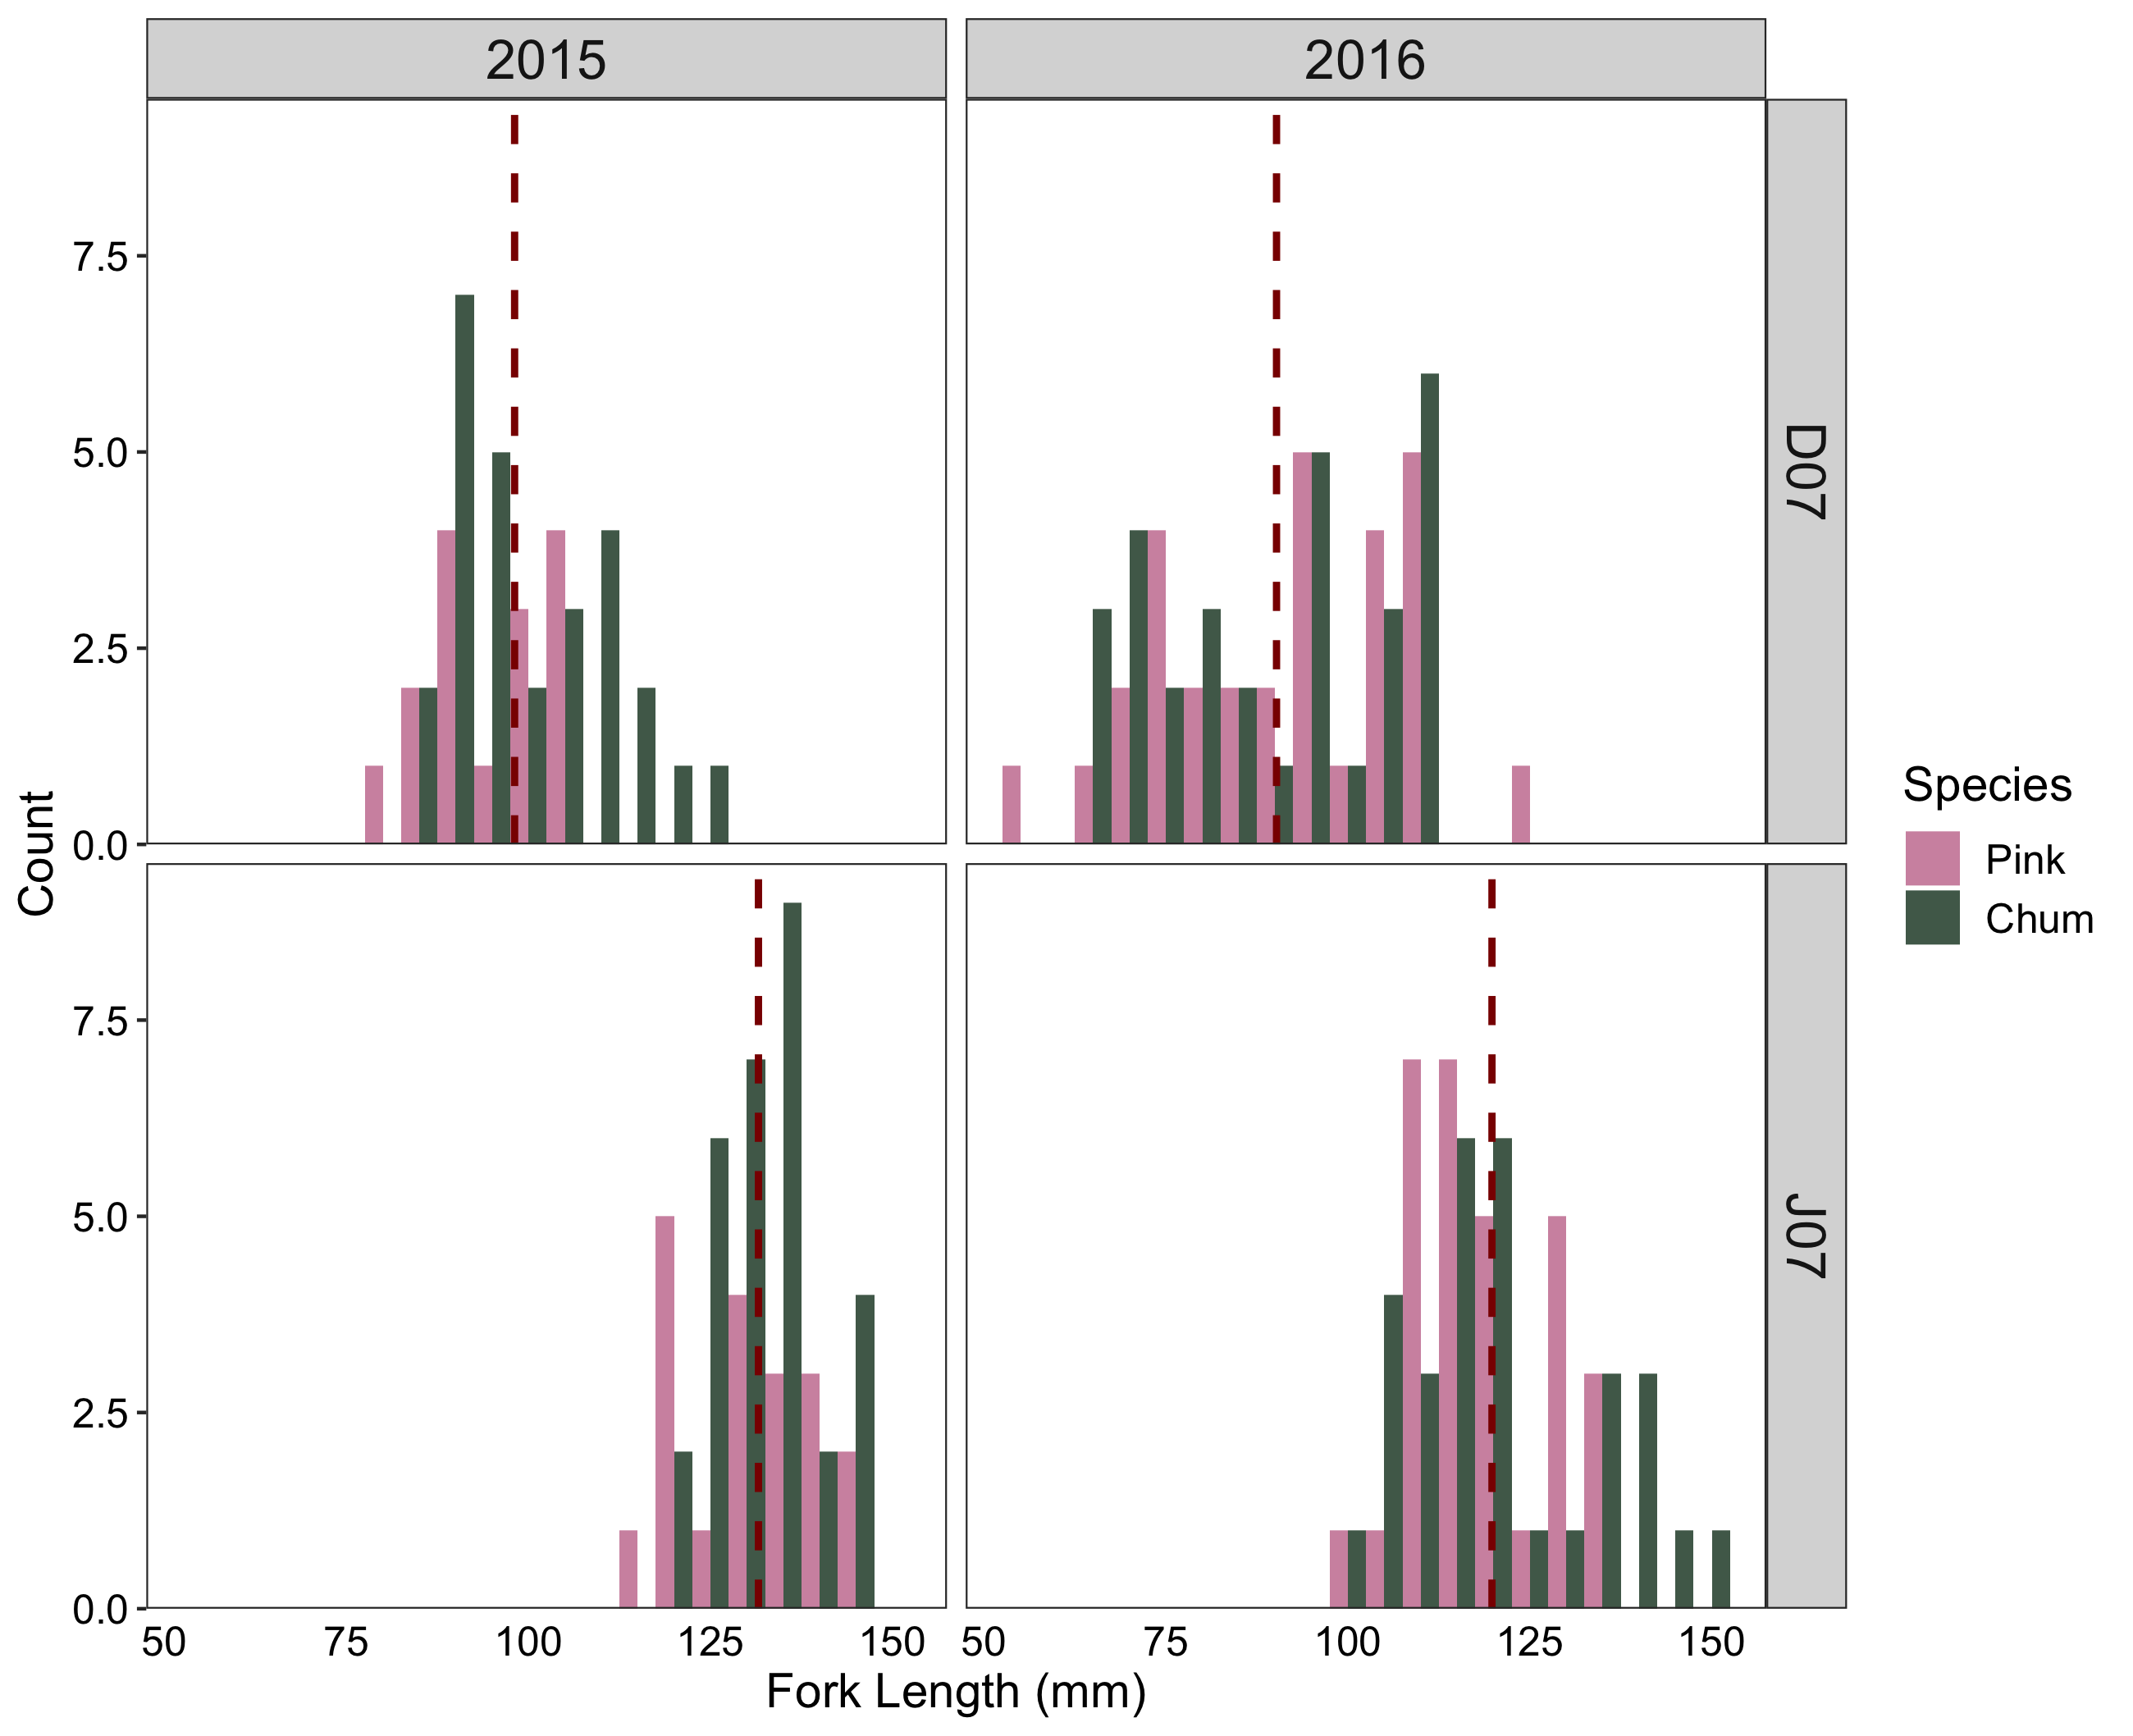
Temporal Data: Pink – Chum Size Frequency

Slide 31
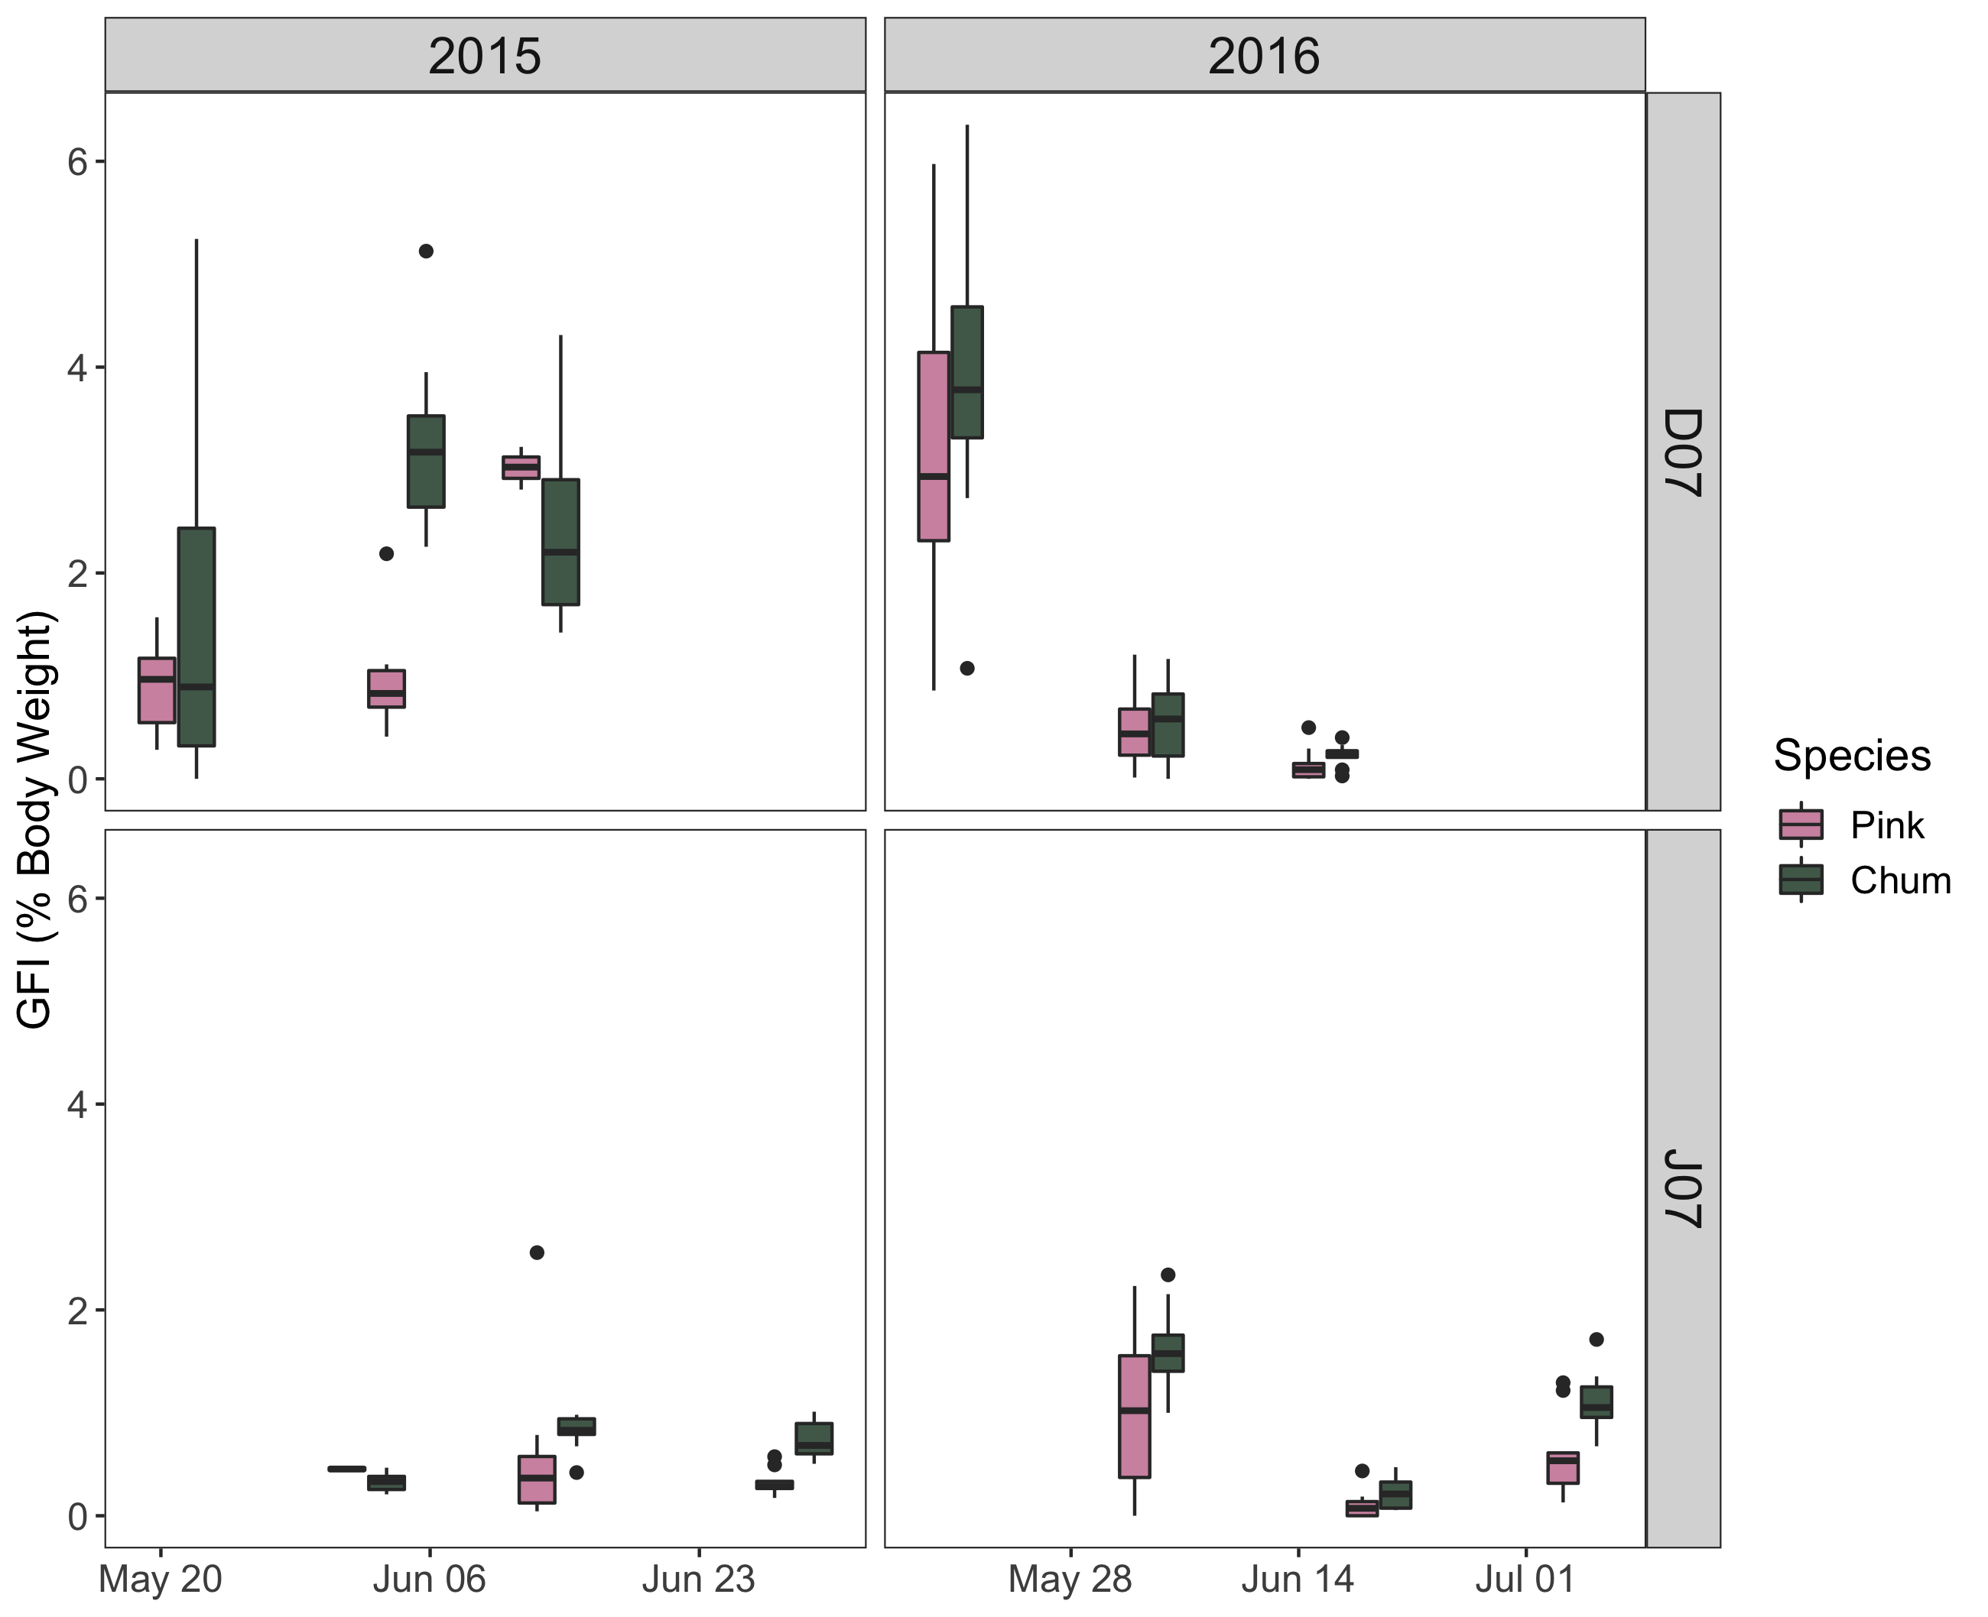
Temporal Data: Pink – Chum Gut Fullness

Slide 32
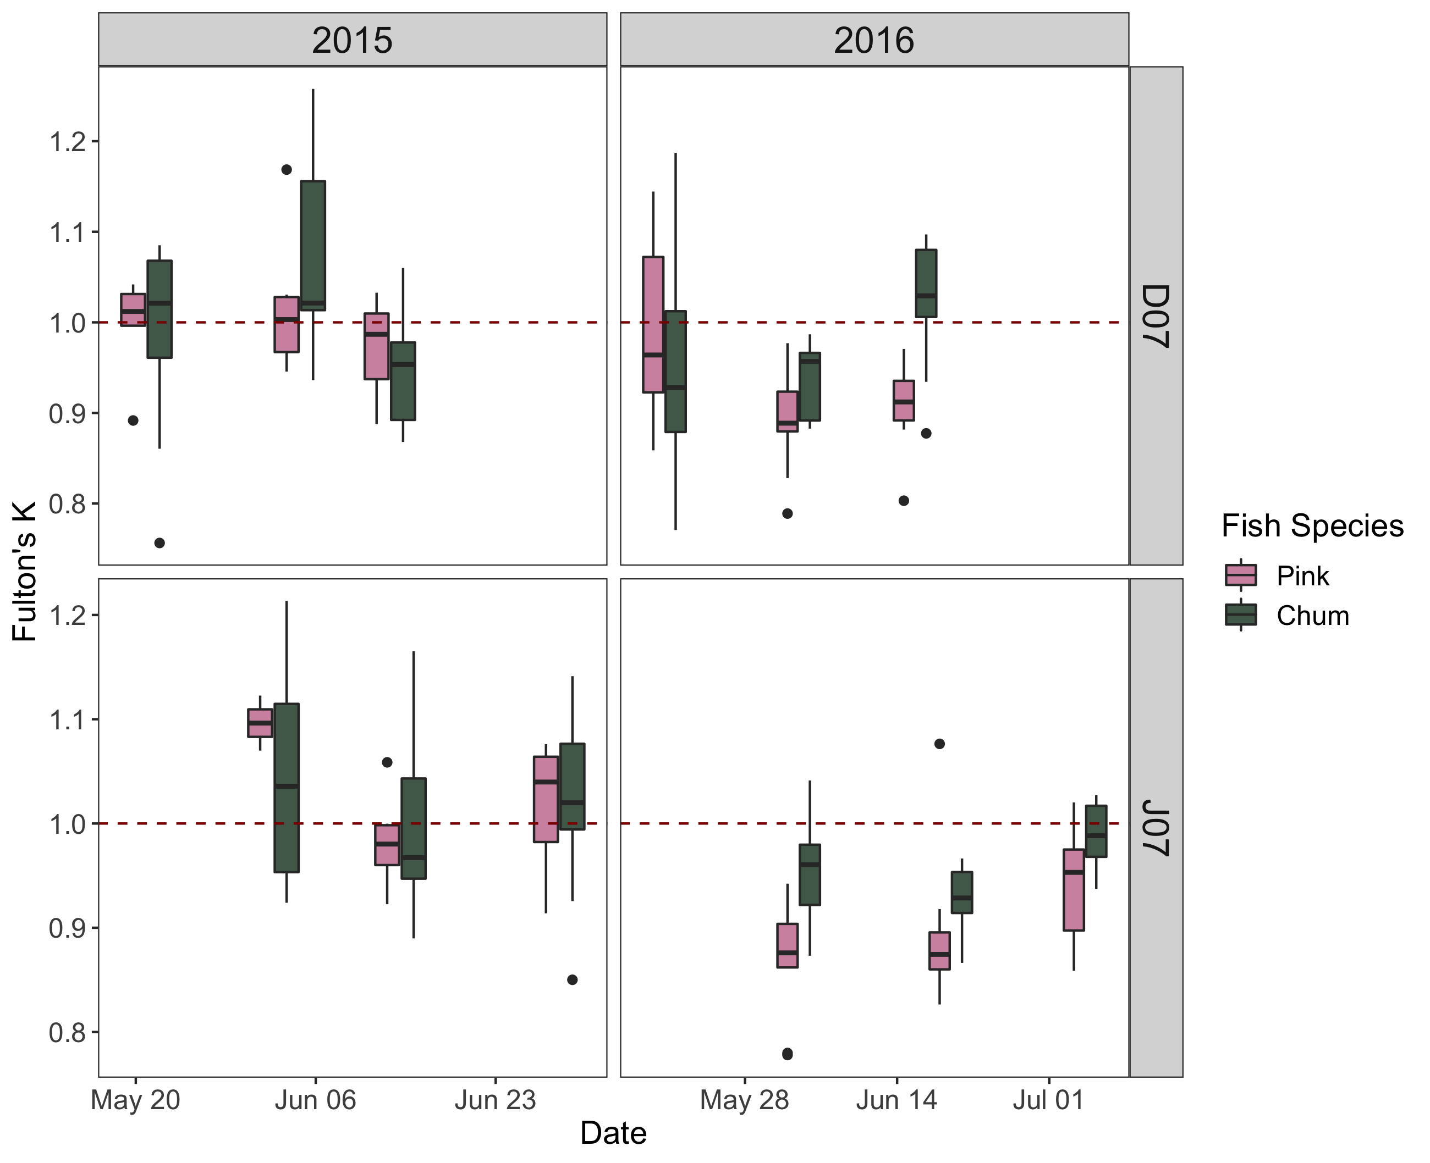
Temporal Data: Pink – Chum Condition Factor

Slide 33
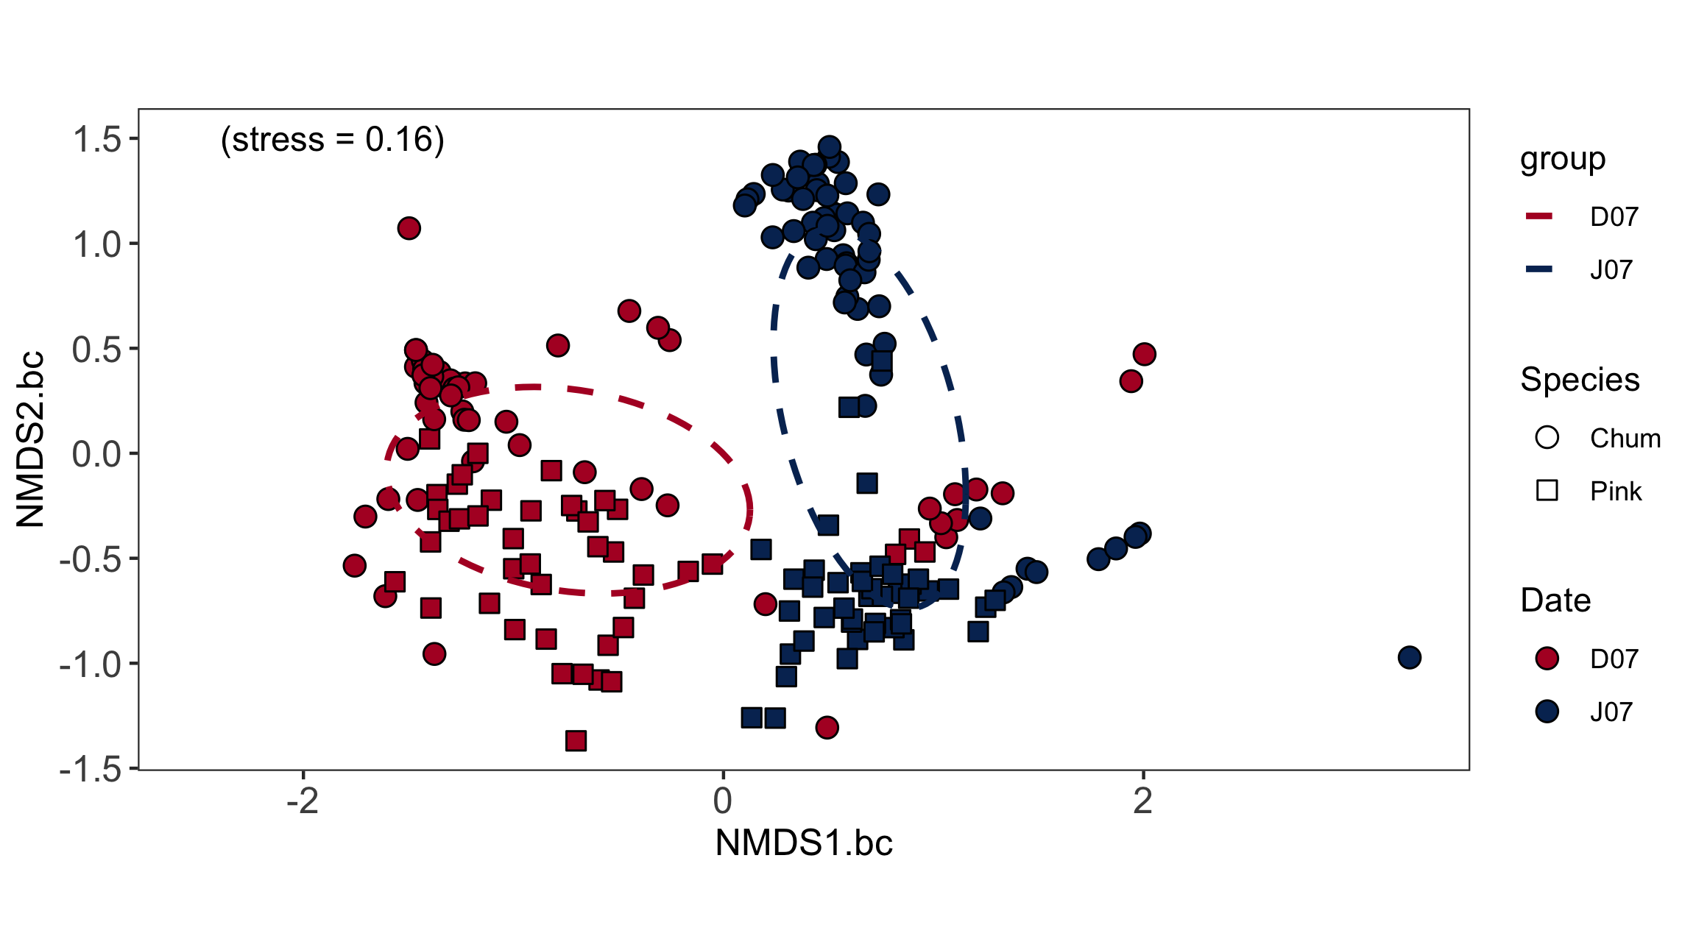
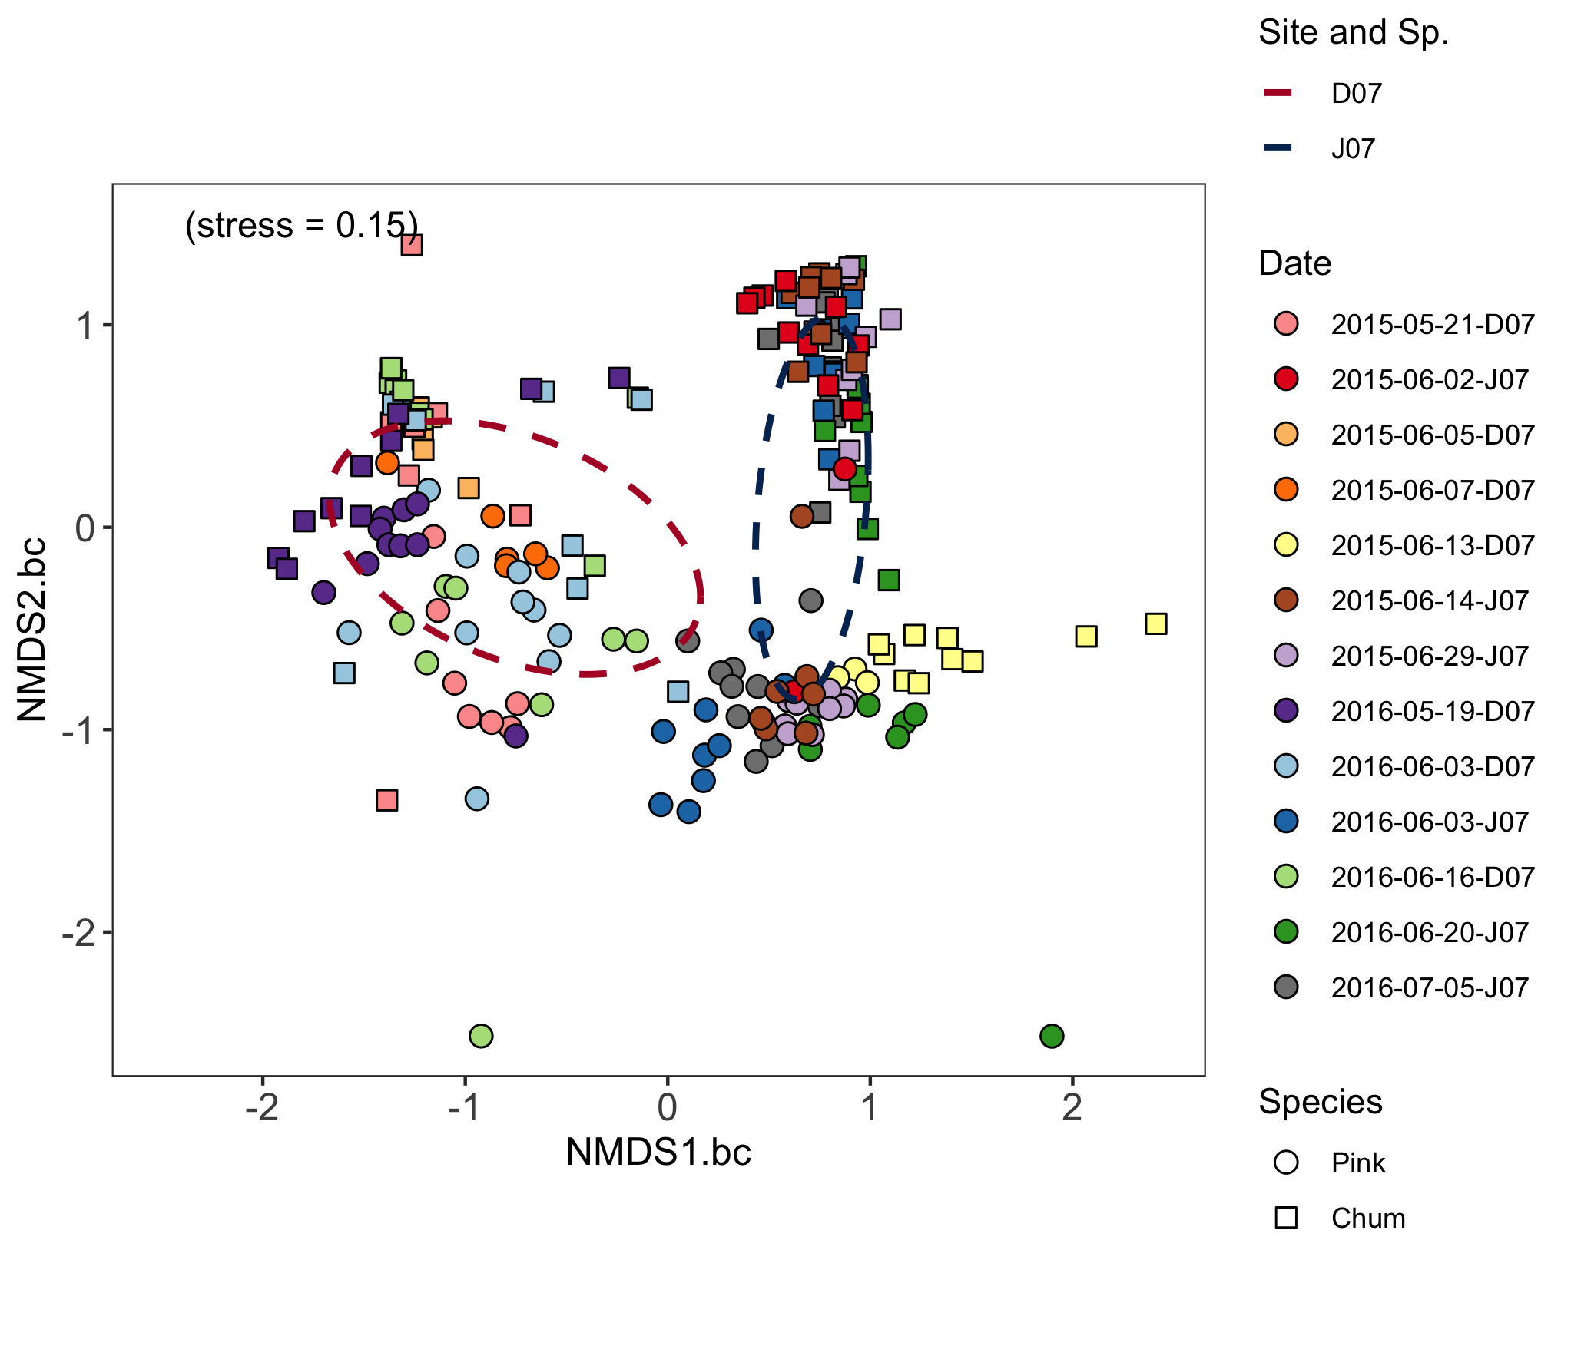
Temporal Data: NDMS

Slide 34
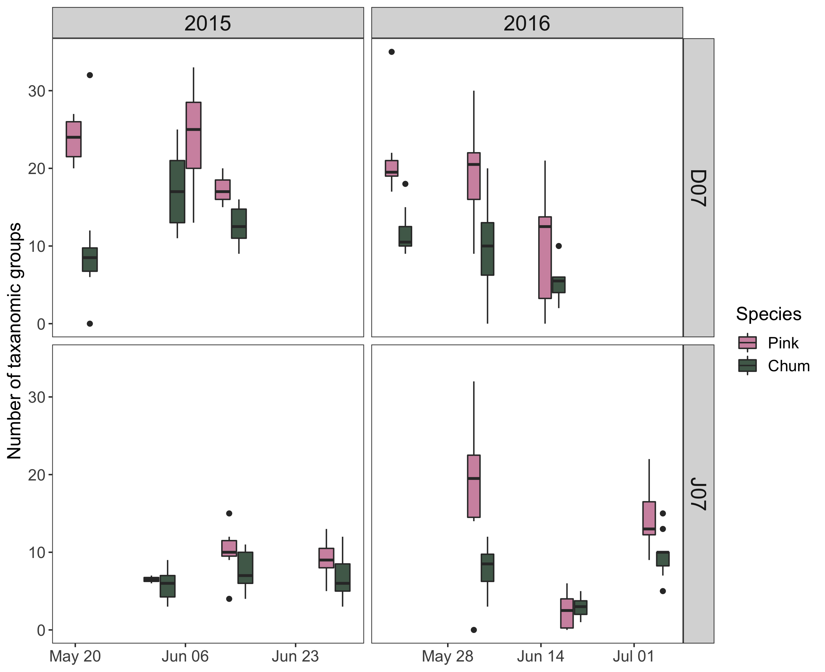
Temporal Data: Prey Richness (Diversity TBD)

Slide 35
Temporal Data: Analysis Still to Come…
BIO-ENV model of diet x temperature, salinity, Secchi, fish FL and WW, year, yday, GFI, overlap, condition K, zoop. Biomass
Potentially plot BIO-ENV model arrows onto NMDS diet composition
Spearman’s rank correlations for GFI x all the variables listed above
… niche stuff? And/or do it for the spatial part … ?
Partial redundancy analysis (pRDA) to account for differences in DI/JS
Look into diet trends that could be related to species, size, seasonality
Perform ANOSIM and SIMPER … Diversity indices … FO% of species…

Slide 36
Temporal Data: Preliminary Discussion
TBD …

Slide 37
Temporal Data: Preliminary Summary/Conc.
TBD …

Slide 38
Conclusion
Knowledge gap of coastal juvenile pink and chum feeding competition
This study defined diet and habitats in contrasting foraging conditions
In high foraging conditions, pink and chum consume same prey types
Queen Charlotte Strait hot spot: calanoids, euphausiids, chaetognaths
Trophic Gauntlet (low foraging): pink in littoral, chum eat gelatinous
Prey partitioning by species can help decrease potential competition
Diets of pink and chum salmon can be used as ecosystem indicators
Further multi-species research is needed on competition in gauntlet

Slide 39
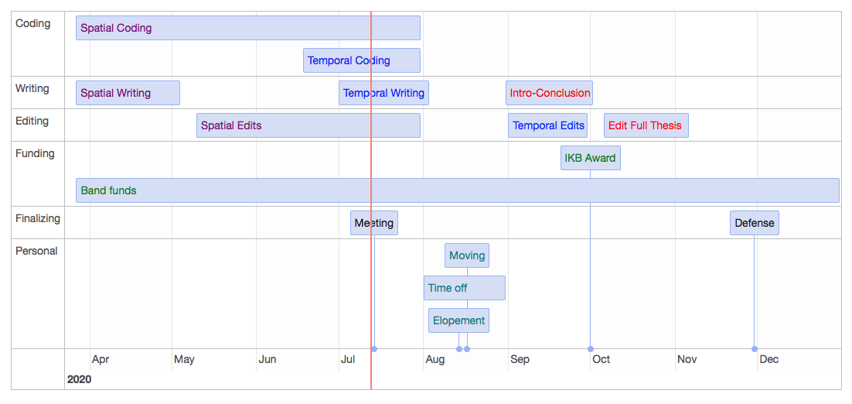
Timeline
Notes:
Sept 23 last meeting, Nov 1 lab work; org. data/code, reading papers/analysis, tables/figs, writing/editing

Slide 40
Extra Slides (Graphs & Tables)

Slide 41
Temporal Data: Pink – Chum Diet (%WW) +

Slide 42
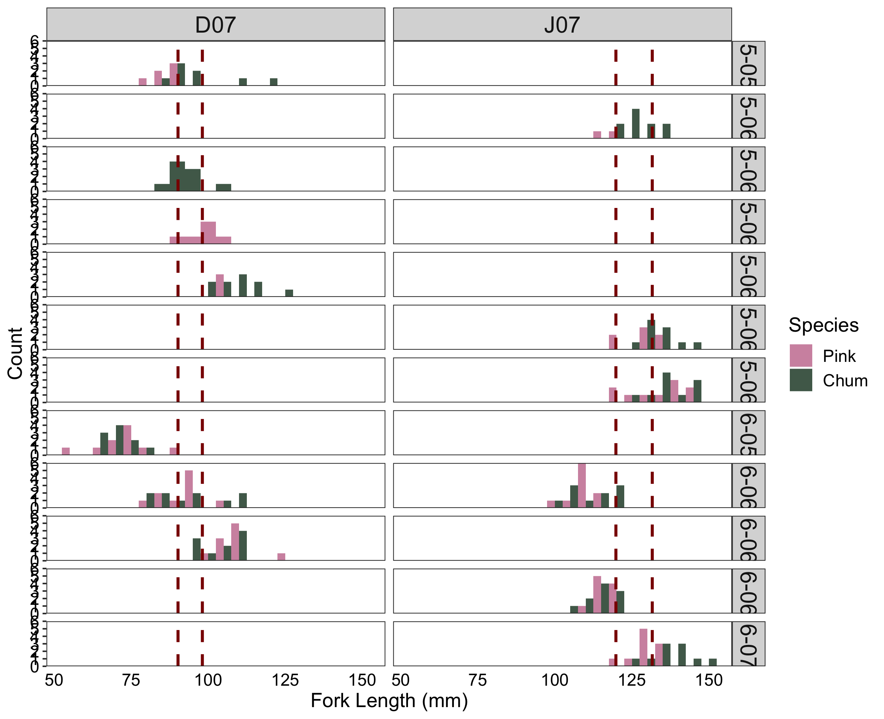
Temporal Data: Pink – Chum Size Frequency +

Slide 43
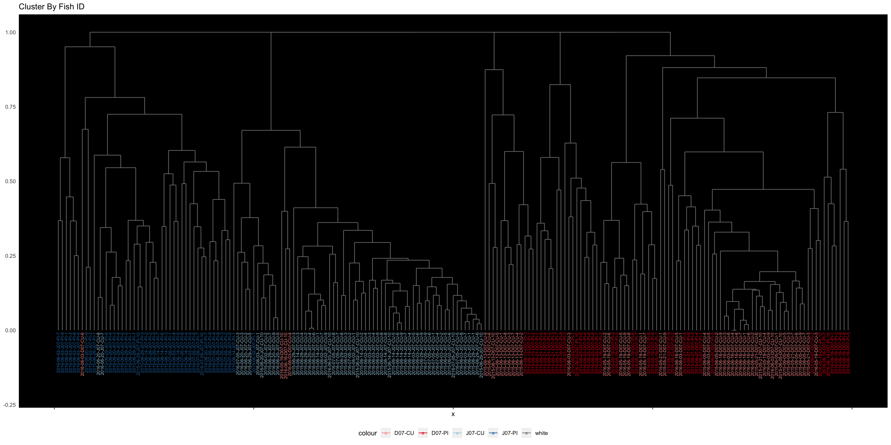
Temporal Data: Cluster
NEEDS UPDATING … ONLY HAVE OLD VERSION

